Slide 1



POWER BI PRESENTATION
ECOMMERCE SALES DASHBOARD
Presented by: RITESH PATIL

Slide 2

OVERVIEW
01
02
03
Objectives
Data Overview
Visualizations

Slide 3

OBJECTIVES
1. Profitability Analysis
• Profits by category.
• Profits by Month.
2. Customer & Regional Insights
• Sales distribution by state.
• Customer purchase trends and frequent buyers.
• Identify regions with the highest and lowest sales.
3. Order & Payment Mode Analysis
• Most preferred payment methods.
• Payment mode distribution by category.
• Average order value per payment mode.

Slide 4


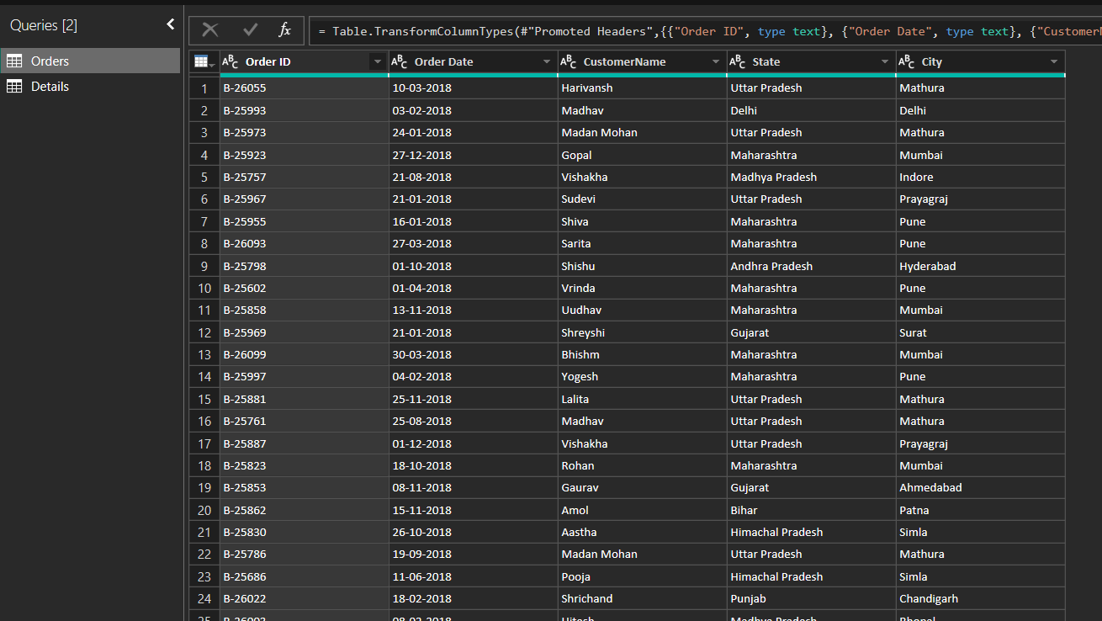
DATA OVERVIEW
Table - 1

Slide 5
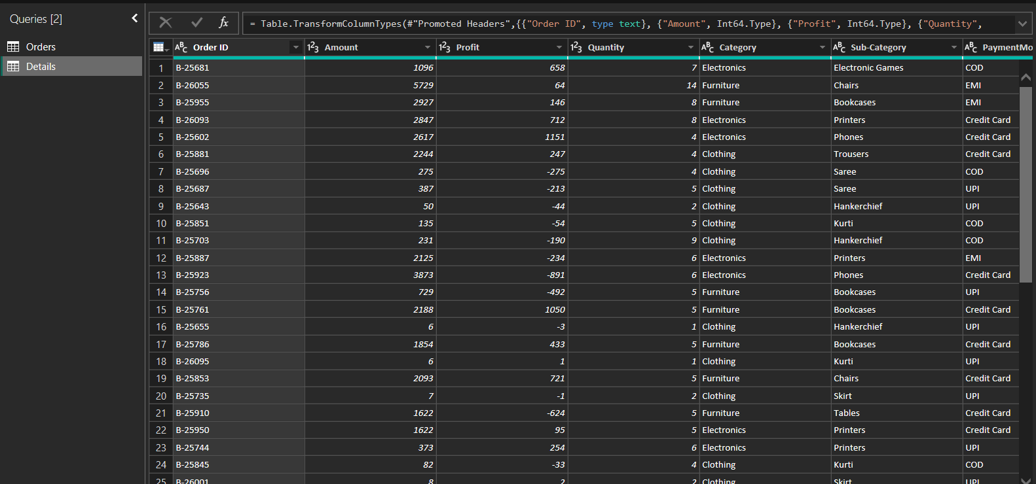
DATA OVERVIEW
Table - 2

Slide 6
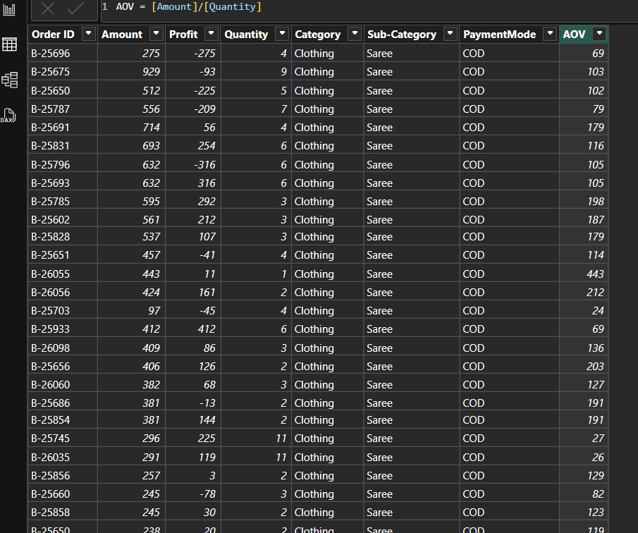
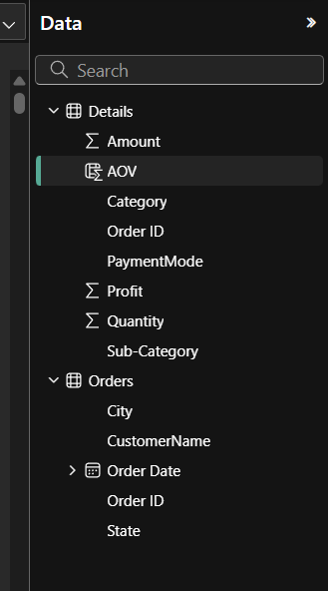
COLUMN CREATION

Slide 7

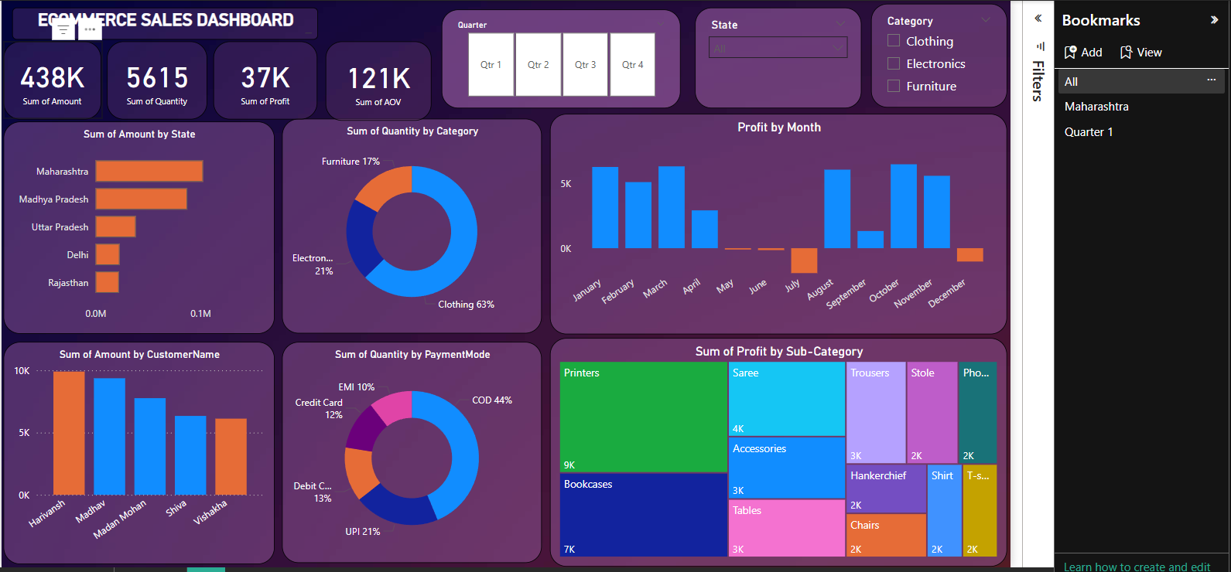
DASHBOARD VISUALIZATION

Slide 8
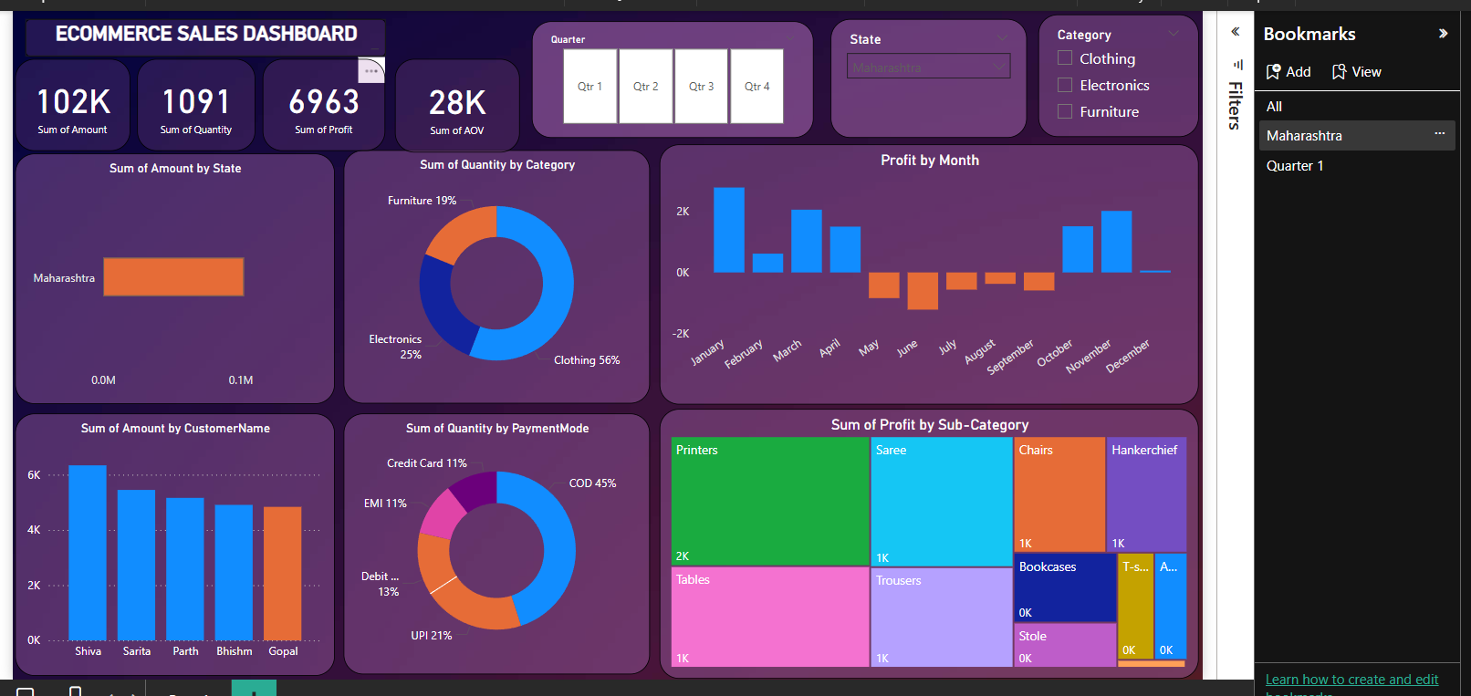
DASHBOARD VISUALIZATION

Slide 9
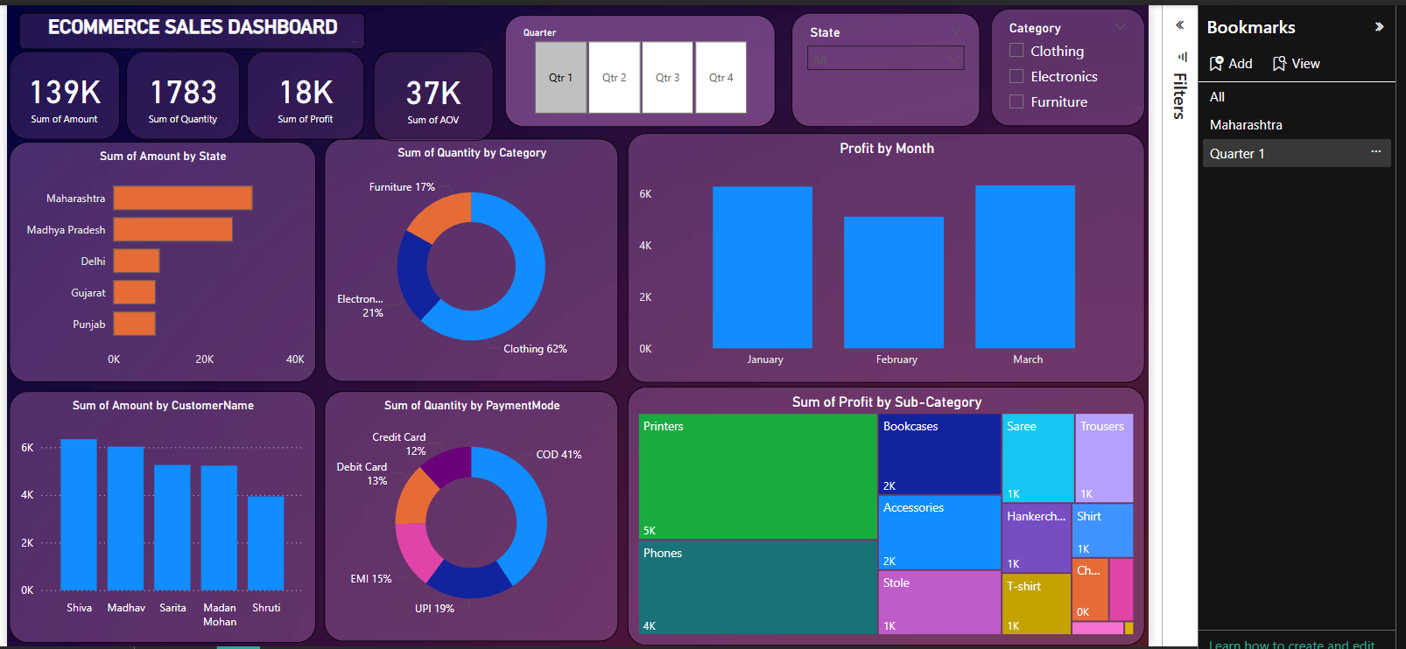
DASHBOARD VISUALIZATION

Slide 10
THANK YOU!!!

